Slide 1

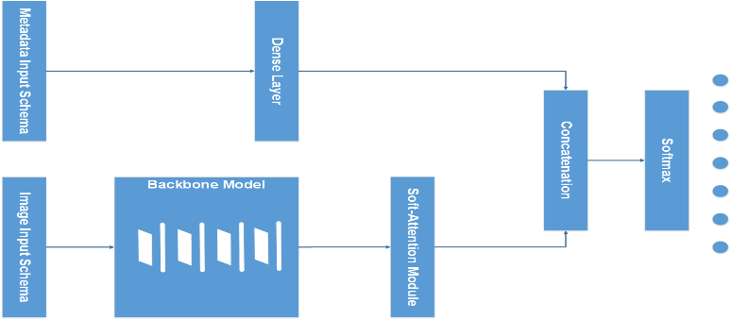
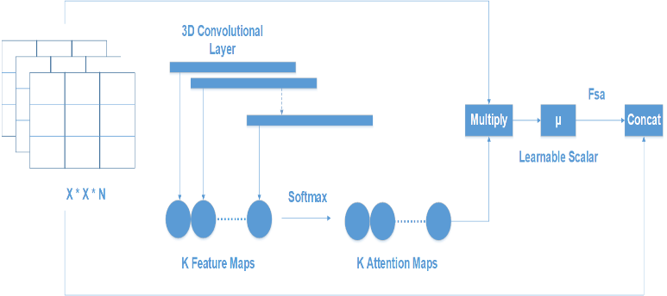
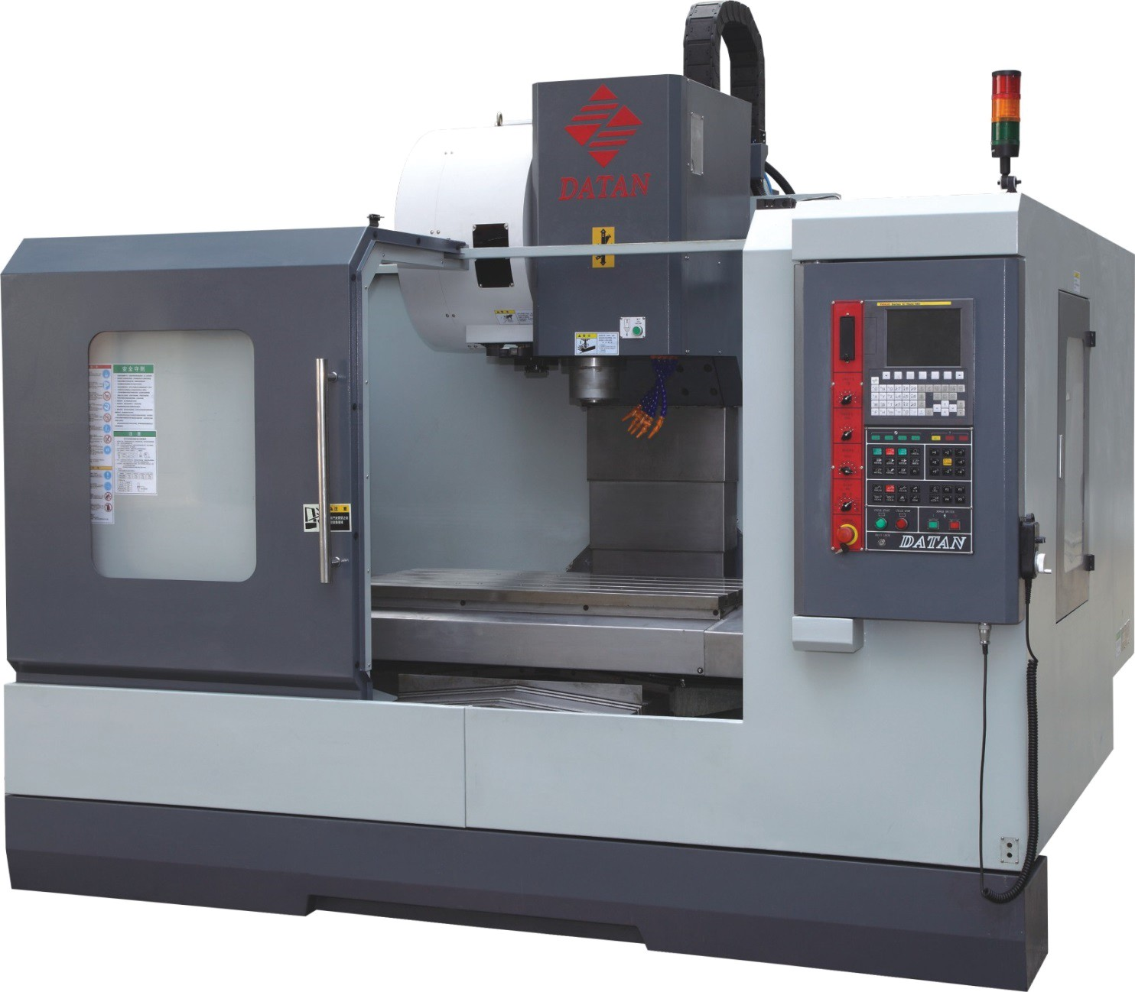
TITLE: DIAGNOSTIC SUPPORT OF SKIN LESION CLASSIFICATION USING CNN AND SOFT ATTENTION
Sinh viên: Đỗ Hoàng Khôi
Giáo viên hướng dẫn: TS. Nguyễn Việt Dũng Trường Điện – Điện tử – Đại Học Bách Khoa Hà Nội
Introduction
Today, the rapid development of industrial zones leads to an increased incidence of skin diseases because of polluted air. According to a report by the American Cancer Society, it is estimated that in 2022 there will be about 100,000 people suffering from skin cancer and more than 7600 of these people will not survive. In the context that doctors at provincial hospitals and health facilities are overloaded, doctors at lower levels lack experience and having a tool to support doctors in the process of diagnosing skin diseases quickly and accurately is essential.
In this paper, the effect of metadata on classifying skin disease is also analyzed. On the other hand, by analyzing the combination of several backbone models, I will also construct an optimized model that has the ability to classify in a balanced way between classes instead of well identifying the majority of classes.
Experiment Implementation
MobileNetV3Large | Acc
MobileNetV3Large-Layer[:246] + Soft-Attention + Metadata | 0.84
MobileNetV3Large-Layer[:240] + Soft-Attention + Metadata | 0.86
MobileNetV3Large-Layer[:230] + Soft-Attention + Metadata | 0.84
Overall Model
MobileNetV3 indicator
Accuracy | 0.86
Precision (avg) | 0.86
F1-score (avg) | 0.86
Recall(avg) | 0.86
The expected result of the f1-score and recall score was 0.81 as opposed to 0.71.
MobileNetV3Large performance is nearly equal to DenseNet201 and InceptionResNetV2though its parameter is small.
Soft-Attention Module
Purpose, Research Subjects
The purpose of this paper is to create a supporting diagnosis system for skin lesion classification. This system can be used on the cloud, mobile or electronic devices.
The research subjects of this paper are Deep Learning models:
DenseNet: DenseNet201
InceptionNet: InceptionResNetV2
ResNet: ResNet50, ResNet152
NasNet: NasNetLarge, NasNetMobile
MobileNet: V2, V3Small, V3Large
Result and Discussion
Conclusion
In this paper, the objectives are to analyze the effect of metadata on the performance of the model and construct an optimized and balanced model that can be used on mobile phones or electronic devices. The experiment shows that metadata improves the model performance, the factor that makes the model much more imbalanced is the augmented data. This problem can be solved by using the aforementioned weighted loss function. Using the weighted loss function makes the expected value of model f1-score and recall score increase. At the end of the experiment, the mobile model is found that can achieve great performance without either a large number of parameters or depth.
Development
Research and develop a more optimized model
Use more datasets: BCN5000, VEXC,… to increase the number of diseases detected.
Reference
Soumyya Kanti Datta, Mohammad Abuzar Shaikh, Sargur N. Srihari, and Mingchen Gao. Soft-attention improves skin cancer classification performance. Available at https://arxiv.org/abs/2105.03358, 4 Jun 2021
Rishu Garg, Saumil Maheshwari, and Anupam Shukla. Decision support system for detection and classification of skin cancer using CNN. Available at https://arxiv.org/abs/1912.03798, 9 Dec 2019

